Slide 1
Book Recommendation System for Goodreads
Capstone Project
By: Justin Hughes-Coleman

Slide 2
Problem Statement
Goodreads has millions of user ratings for books
Does not have recommendation system for users to read new books
Companies like Netflix have been developing systems for over a decade
Apply this system to other user-provided data aggregate companies

Slide 3
Deliverables
Basic script algorithm that allows a user to input book title and a list of recommended books will populate.
Possible development into a webapp

Slide 4
Data Description
Using a Goodreads provided dataset that contains 10,000 books reviewed by six million users
Of the initial 22 columns, several were removed from the data analysis as the information was redundant or irrelevant (i.e. two columns for book title and original title; isbn 10 and isbn 13)
Removed Farsi language books because they had low review counts
Most books have English reviews even if book is originally in a different language

Slide 5
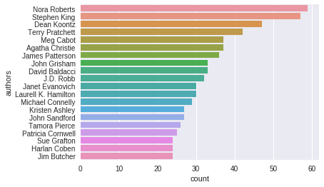
Exploratory Data Analysis
The dataset contains books from the most reviewed books on the Goodreads platform.
10,000 books written by less than 5,000 authors on average.
There were no statistical significance comparing book Year and Rating.
Little statistical significance between number of ratings and number of user generated book tags.

Slide 6
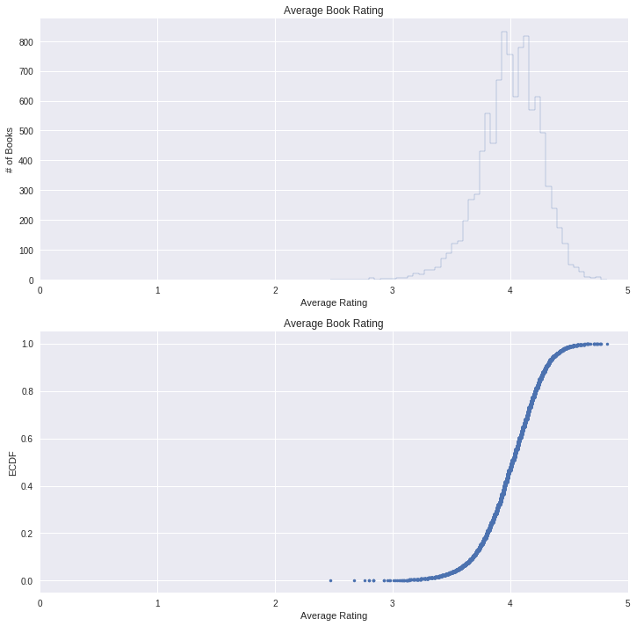
Statistical Analysis
Correlation testing was done against all numerical data
Average book rating was 4.06 with the majority of ratings being with 0.5 of that score
Illuminates selection bias among users but also follows expectations of dataset

Slide 7
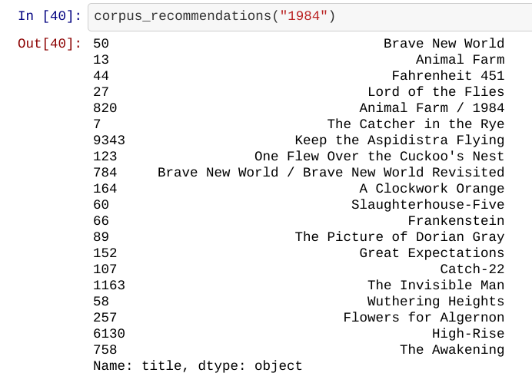
Text Analysis
Transformed text using TF-IDF
Algorithm used for analysis was Cosine Similarity
Constructed a function that takes the vectorized array created by TF-IDF and uses the Cosine Similarity algorithm to analyze the data
Best results came from analyzing both author names and book tag-names

Slide 8
Results
Method used effectively generates book recommendations based on input of book title
Limitation: Book must be listed in the Goodreads dataset
Solution: Incorporate all books from Goodreads database to get recommendations from all books
Limitation: Doesn’t recommend books outside of genre
Solution: Incorporate a Goodreads defined genre system to consolidate the user-generated tag-names; allowing for supervised (classification) learning.

Slide 9
Thank you for reading!

